Slide 1
Industrial espionage in cyberspace
Shaharyar
M Raheal Safdar​

Slide 2
AGENDA
Know what is meant by industrial espionage.
Understand the low-technology methods used to attempt industrial espionage.
Be aware of how spyware is used in espionage.
Know how to protect a system from espionage

Slide 3
Introduction
In media espionage is referred as something glamorous or adventure. In real espionage is a way of obtaining information that would not otherwise be made available.
Espionage is best done with as little fanfare as possible.
Obtaining information without target organization even realizing.

Slide 4
espionage is done by:
Governments, Intelligence Agencies, Terrorists.
Above mentioned are not only entities engaged in espionage. These organizations desire to acquire information for political and military goals.
Espionage is also done by private companies for economic gain, and it is growing day by day.

Slide 5
What is industrial espionage
Industrial espionage is simply the use of spying techniques to find out key information that is of economic value.
Such data might include:
Details on a competitor’s new project
List of a competitor’s clients
Research data
While the rationale for corporate espionage is different from military espionage but methods used are same.
Electronic monitoring
Photocopying files
Compromising a member of the target organization

Slide 6
Types of industrial espionage
Ip theft
Property trespass
Hiring away employees
Wiretapping
Cyber attacks
the appropriation of unique ideas, inventions or other information by parties without permission to borrow or reuse it.
Breaking into physical premises or files to obtain company info:
Hire away employees from companies to gain access to information the companies have acquired.
Setting up portable devices that listen in or record certain conversations.
Organizations seek to disrupt each other by sabotaging daily operations, like DDoS.

Slide 7
Information as an asset
Many people are used to viewing tangible objects as assets but have difficulty appreciating how mere information can be a real asset.
Companies spend billions of dollars every year on research and development.
Information is valued as below:
VI (value of information) = C (cost to produce) + VG (value gained)
Information is a real commodity. It is as much an economic asset as any other item in the company’s possession.
In fact, it is most often the case that the data residing on a company’s computer is worth far more than the hardware and software of the computer system itself.
Example for understanding Information as a commodity can be the process of earning a college degree.

Slide 8
Real world examples of industrial espionage
Professor Hao Zhang.
General Motors.
Interactive Television Technologies Inc.
Bloomberg Inc.

Slide 9
How does espionage occur
There are basically two ways through which espionage can occur.
Low-Tech Industrial Espionage
More Technology-Oriented Method
These two are further discussed in upcoming slides.

Slide 10
Low-tech industrial espionage
Current or former employees simply take the data.
Someone to use social engineering methods to extract data from unsuspecting company employees.
One method of social engineering used to extract sensitive data is direct conversation with target employees.
Second way is using social engineering via email.
Disgruntled employees are the single greatest security risk to any organization whether the method is used technological or not.
USB flash drives or compact discs CDs used for taking information which is not much technological oriented.

Slide 11
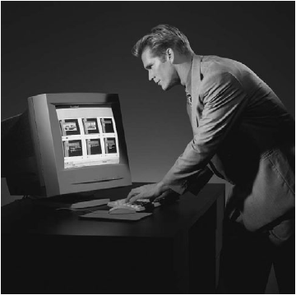
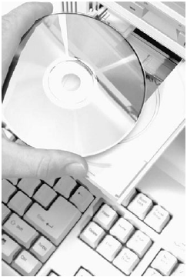
Low-tech espionage is easy & portable

Slide 12
More tech-oriented industrial espionage
Software that can monitor activities on a computer can be used in industrial espionage.
One method to accomplish monitoring is via spyware.
Cookies
Keyloggers
Capturing Screenshots
Steganography

Slide 13
Protecting against industrial espionage
You can not make any system totally secure, totally unbreakable security is just a myth.
Following are some ways through which you can secure you system or information.
Employ antispyware software.
Use firewalls and intrusion-detection systems.
Implement security policies.
Encrypt all transmissions.

Slide 14
How to lessen risk of internal espionage
Give out data on “need to know” basis.
Ensure no one person has control over all critical data at one time.
Limit portable storage media and cell phones.
No documents/media leave the building.
Do employees background check.
Lock up tap backups, documents, and other media.
Encrypt hard drives of portable computers.
Carefully screen new hires.
Monitor employee activity.
Secure physical assets and premises.
Secure digital assets.

Slide 15
continue
12. Fully patent companies designs, inventions, and discoveries.
13. Audit your security regularly.

Slide 16
conclusion
Industrial espionage does indeed occur.
It is an unfortunate, but quite real, aspect of modern business.
If your firm’s management chooses to ignore these dangers, then they do so at their own peril.

Slide 17
THANK YOU

